Slide 1
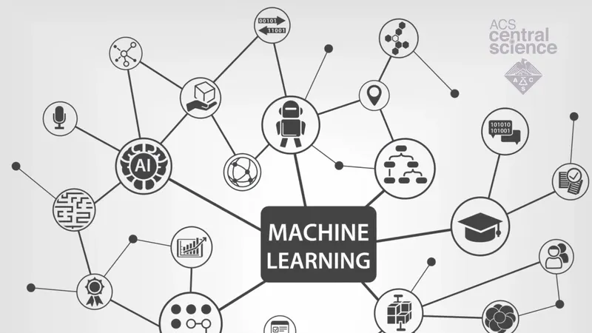

Supervised Learning Project
By: Rana Al-suffi

